Slide 1

INSTRUCTION PIPELINE
MADHUMITHA.S
19PW13

Slide 2
Pipeline processing can occur in data stream as well as in instruction stream
An instruction pipeline reads consecutive instructions from memory while previous instructions are being executed in other segments
This causes fetch and execute phases to overlap and perform simultaneous operations

Slide 3
Consider a computer with an instruction fetch unit and an instruction execution unit designed to provide a 2 segment pipeline
The instruction fetch segment can be implemented by means of a FIFO buffer
The buffer acts as a queue from which the control extracts the instructions for the execution unit

Slide 4
CONTENTS
Instruction cycle
Four segment instruction pipeline
Pipeline conflicts
Data dependency
Handling of branch instructions

Slide 5
INSTRUCTION CYCLE
Computers with complex instructions require other phases in addition to the fetch and execute to process an instruction completely.
Different segments may take different times to operate on the incoming information .Some segments are skipped for certain operations.
Two or more memory segments may require memory access at the same time ,causing the one segment to wait till the other segment is finished.

Slide 6
Memory access conflicts are resolved by using two memory buses for accessing instructions and data in separate modules.in this way an instruction word and the data word can be read simultaneously from two different modules.
Design of an instruction pipeline will be most efficient if the instruction cycle is divided into segments of equal durations.

Slide 7
Four segment pipeline

Slide 8
Assume that decoding of instruction can be combined with calculation of the effective address into one segment and also that most of the instructions place the result into a processer register so that the instruction execution and storing of the result can be combined into one segment .
This reduces the instruction pipeline into 4 segments.

Slide 9
Timing of instruction pipeline
The time in the horizontal axis in divided into steps of equal duration.the four segements are represented in the following diagram with abbreviated symbols.
FI is the segment that fetches an instruction
DA is the segment that decodes the instruction and calculates the effective address
FO is the segment that fetches the operand
EX is the segment that executes the instruction

Slide 10
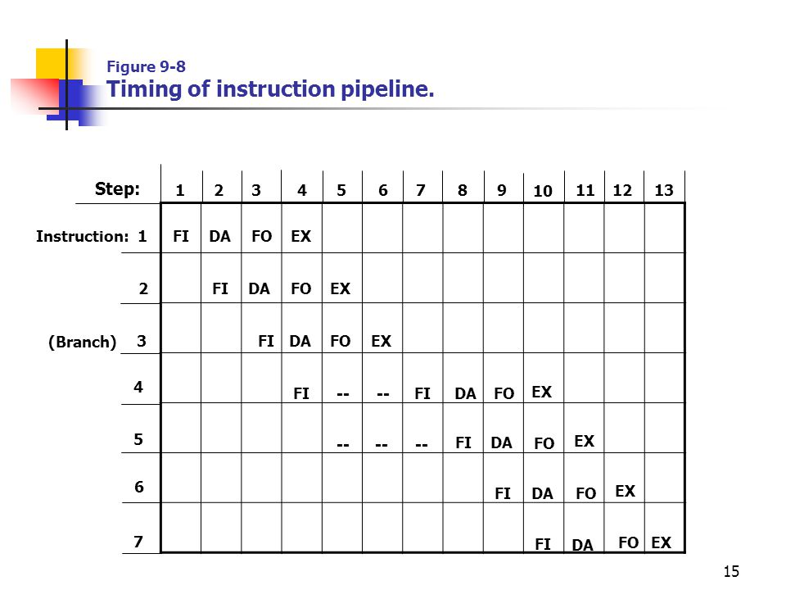


Slide 11
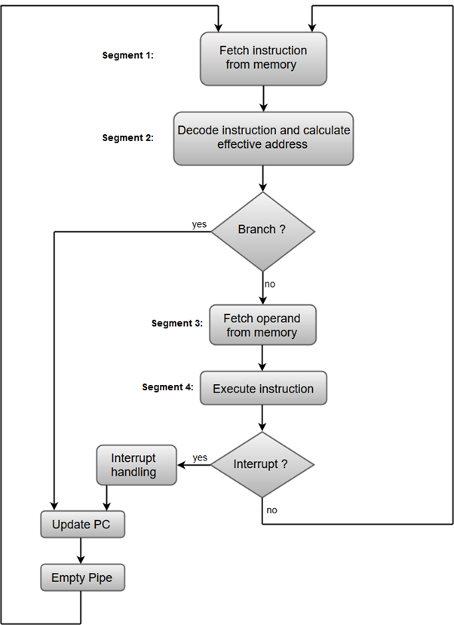
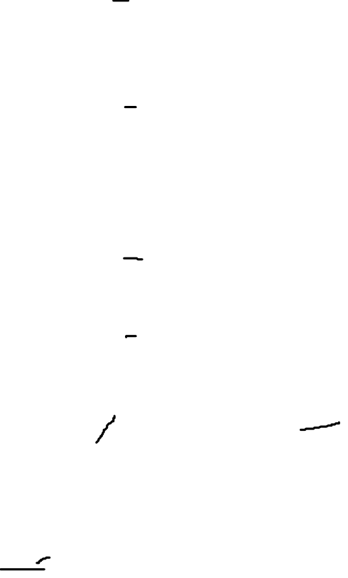

Slide 12
PIPELINE CONFLICTS

Slide 13
Resource conflicts is caused by access to memory by 2 segments at the same time.
Data dependency conflicts arise when an instruction depends on the result of previous instruction,but this result is not yet available
Branch difficulties arise from branch and other instructions that change the value of PC.

Slide 14
DATA DEPENDENCY

Slide 15
What is data dependency ?
It is a difficulty that occurs due to possible collision of data or address
It may cause a degradation of performance in instruction pipeline
A collision occurs when instruction cannot proceed because previous instructions did not complete certain operations
A data dependency occur when an instruction needs data that are not yet available

Slide 16
Illustration of data dependency conflict
For an instance, an instruction in the FO segment may need an operand that’s been generated at the same time by the previous instruction in segment EX.
Therefore, the second instruction must wait for data to become available by the first instruction.
An address dependency may occur when an operand address cannot be calculated because an information needed by the addressing mode is not available

Slide 17
Dealing with conflicts between data dependencies using pipeline computers
Hardware interlocks :
An interlock is a circuit that detects instructions whose source operands are destinations of instructions farther up in the pipeline.Detection of this situation causes the instruction whose source is not available to be delayed by enough clock cycles to resolve the conflict.

Slide 18
Operand forwarding :
This uses special hardware to detect the conflict and then avoid it by rooting the data through special paths between pipeline segments.
This method requires additional hardware paths through multiplexes as well as the cir uit that detects the conflict

Slide 19
Delayed load:
Few computers give the responsibility for solving data conflicts to the compiler that translates high level programming language into a machine language program.
The compiler for such computers is designed to detect and reorder the instruction to delay loading of conflicting data by inserting no operation instructions

Slide 20
HANDLING OF BRANCH INSTRUCTIONS

Slide 21
TECHNIQUES TO MINIMISE THE PERFORMANCE DEGRADATION
Prefetch target instruction :
Both the target instruction as well as the previous instruction are saved until branch executes
if branch execution is successful it continues from branch target instruction

Slide 22
Branch target buffer :
BTB is an associative memory included in the fetch segment of the pipeline
each entry in the BTB consists address of previous branch instruction and the target instruction for the branch

Slide 23
Loop buffer :
a small very high speed register file maintained by the instruction fetch segment of the pipeline
Branch prediction :
A pipeline with a branch prediction uses some additional logic to guess the outcome of a conditional branch instruction before its executing.

Slide 24
Delayed branch :
Compiler detects branch instructions and rearrange machine language code
Inserts useful instructions that keep pipeline operating without interruptions
An example of this is the insertion of no operation instruction

Slide 25
THANKYOU

